Slide 1
What’s my role in promoting Environmental Literacy?
Joe Davis
Science resource teacher/naturalist
BCPS Office of science
January 26, 2015.

Slide 2
What’s going on in Maryland?
COMAR
NGSS
The Standards
MWEE

Slide 3
What are the issues?

Slide 4
What is the one common thread across all of the issues you discussed?

Slide 5
Who has the greatest opportunity and potential to change people?
We have been in the business of “changing people” for a long time…
Educational and Curriculum Philosophy
Scholar Academic
Social Efficiency
Learner Centered
Social Reconstruction

Slide 6
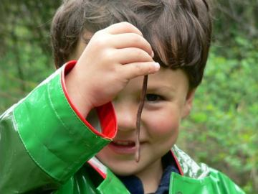
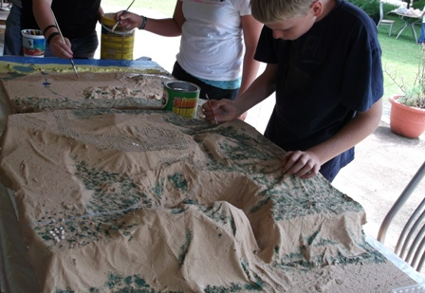
What does the research say? What does the research say?
SEER
Richard Louv No Child Left Inside
What does our heart, mind, and experience say?

Slide 7
Why should we turn the water off when we are brushing our teeth?

Slide 8
Why should we turn the water off when we are brushing our teeth?
Math: What data or information exists or needs to be collected that is related to the problem and needs to be counted, measured, analyzed, displayed or modeled?
Social Studies: How does the issue/problem affect social systems, institutions or people? Have people tackled similar problems in the past or in other places? Is this currently an issue elsewhere? What are they doing about it?
Science: What are the natural systems related to this problem/issue and how are they affected? What variables exist and what happens if you change them?
Language Arts: What information exists already related to the problem/issue? How can I communicate information about the problem/issue or solutions with others?
Art/Music/Phys Ed: In what ways can I share information related to the problem/issue in creative ways to a diverse audience?
Engineering: How do I fix the problem?

Slide 9
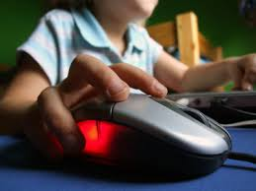
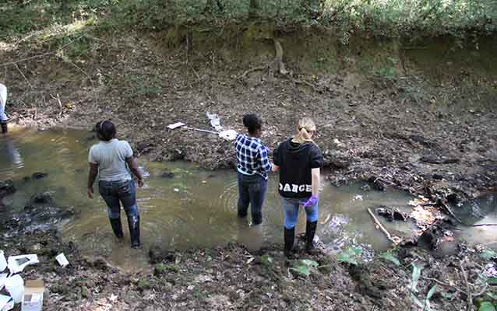
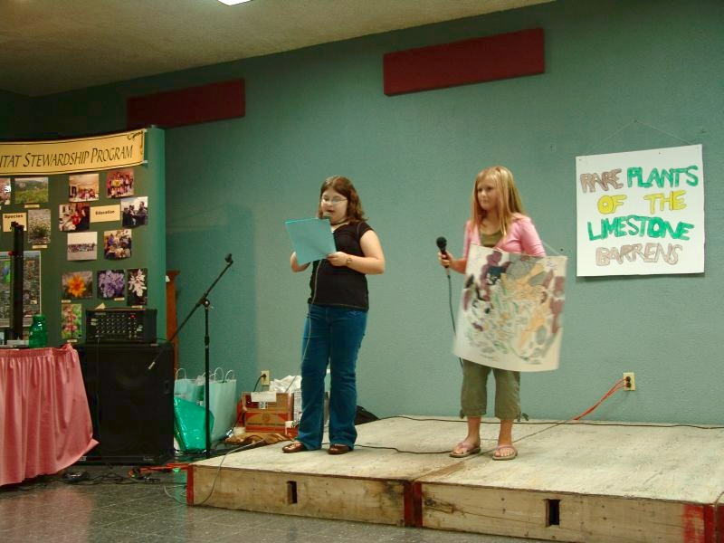
MWEE
Classroom
Fieldwork
Action
Student Products

Slide 10
What does it mean to be a Green School anyway?

Slide 11
