Slide 1
Trout in the Classroom
Connecting students with their watershed
Dundalk Middle School
2014-2015

Slide 2
About Trout in the Classroom
Founded by Trout Unlimited
Formed in New York in 1994
Now in 26 states, spread out all over the US

Slide 3
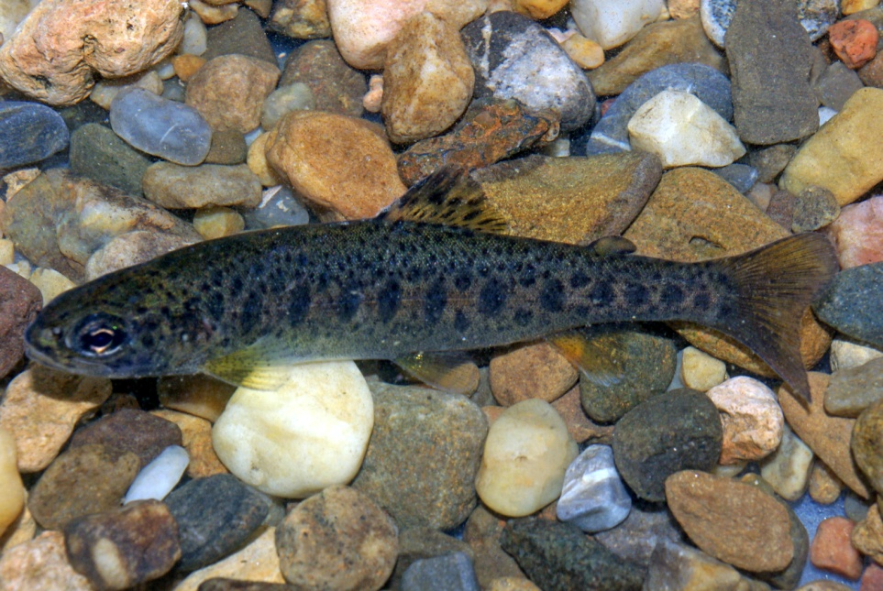
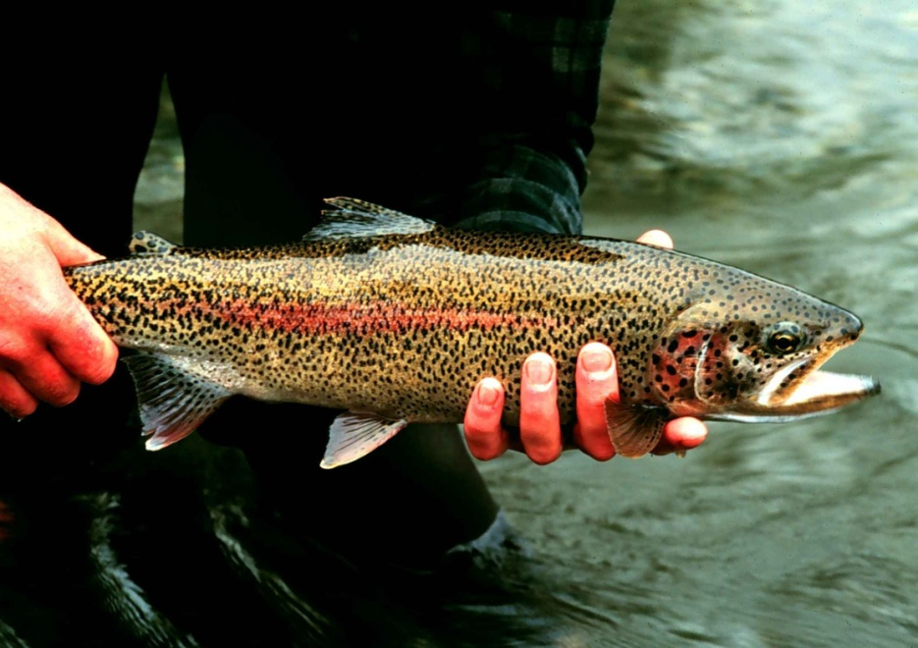
About trout
Found all over the world ( N. America, Europe, Asia, Australia)
Need fresh water ( rivers and streams ) that stays cold!
(50-60 F )
Can grow to about 12 inches long
Eat insects, shrimp, worms,
and even other trout!

Slide 4
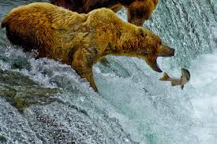
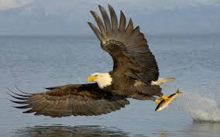
Why do we care about trout?
Trout are an important food source for humans and wildlife including brown bears, birds of prey such as eagles, and other animals.

Slide 5
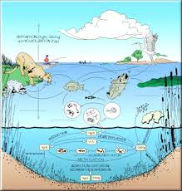
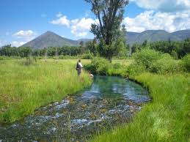
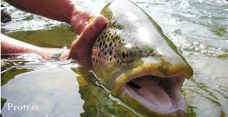
Why do we care about trout?
Since trout are a large part of aquatic ecosystems, they serve as a good indicator species – the overall health of the trout population gives us a good idea about the health of the whole ecosystem.

Slide 6
Why do we care about trout?
Also, trout are very picky about where they live. They need really clean water to survive.
If you find trout in a stream or river, then you know that area has little to no human impact.

Slide 7
BREAD and CHEESE CREEK
IF you were a trout, would you want to live here?

Slide 8
So what are we doing?
Notes:
Students will collect and analyze data about the water quality in our tank. They will raise the trout from egg to fingerlings. All surviving fingerlings will be released into an approved stream in late April / Early May but a select group of students.

Slide 9
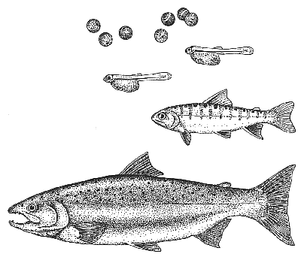
The life of a trout

Slide 10
The life cycle of a trout
At two years old, adult trout can reproduce
Lays 100s, sometimes 1000s of eggs
After 2 to 3 weeks, “ alevin” form.
2-3 weeks later, swim to the surface as “ fry”
Later become fingerlings
Notes:
Alevin are hatchlings from the egg casing that cannot yet swim. Once they hatch they live off of their yolk sacs for quite sometime. Until they swim to the surface, looking to feed. At this point they become “ fry”. Eventually they use up all of their yolk sacs and begin to “ button up “. Once their yolk sac has completely buttoned up, they are called “fingerlings” and are fully formed fish.

Slide 11
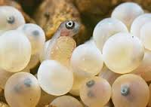
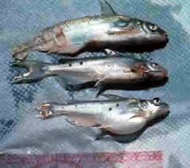
Fingerlings beginning to “button up”.
ALEVIN
Eyed eggs
ADULT
FRY

Slide 12
The Chesapeake Bay Watershed
Dundalk is a huge part of the Chesapeake Bay Watershed.
The Chesapeake Bay Watershed covers 6 states and is made up of the bay and over 100,000 streams and rivers which feed into it.
Home to 17 million people and over 3,600 species of plants and animals.
The Bay produces over 500 million pounds of seafood annually.
Notes:
Home to over 350 species of fish and over 170 species of shellfish

Slide 13
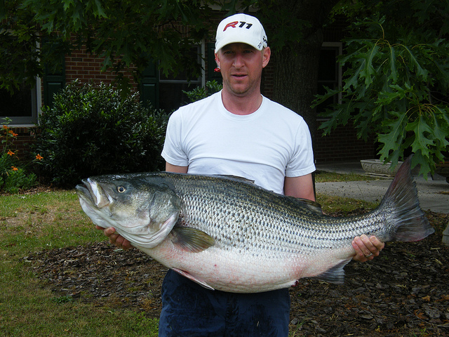
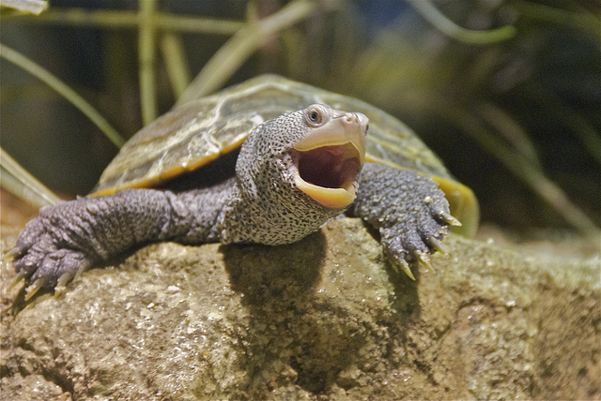
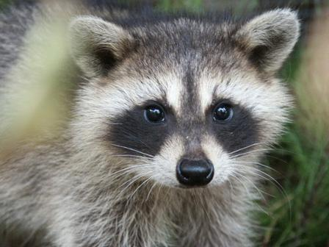
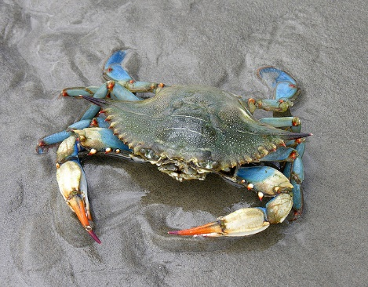
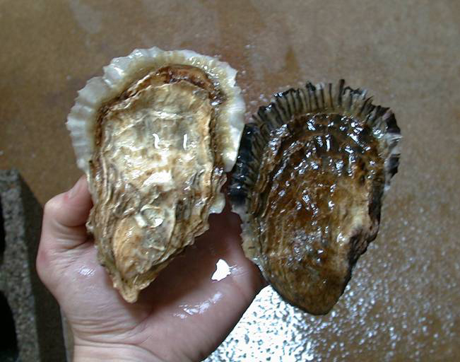
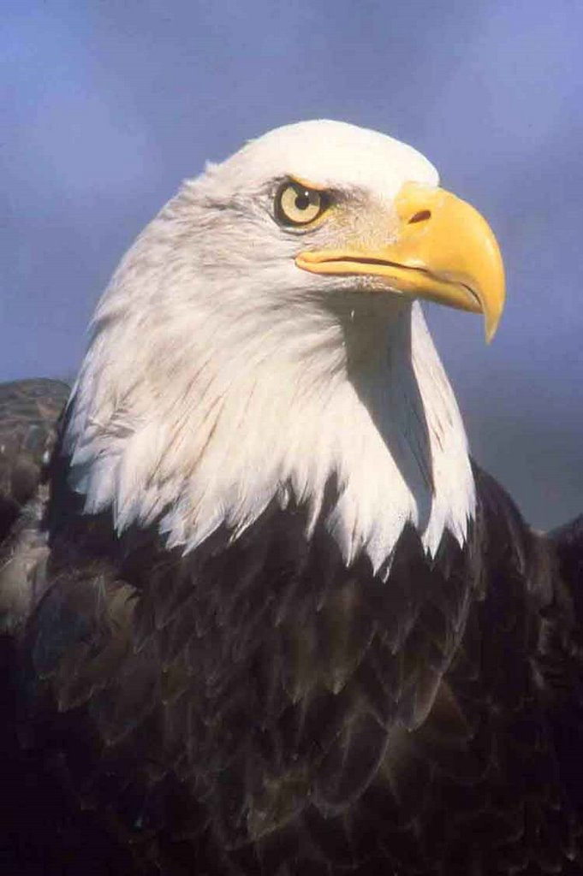
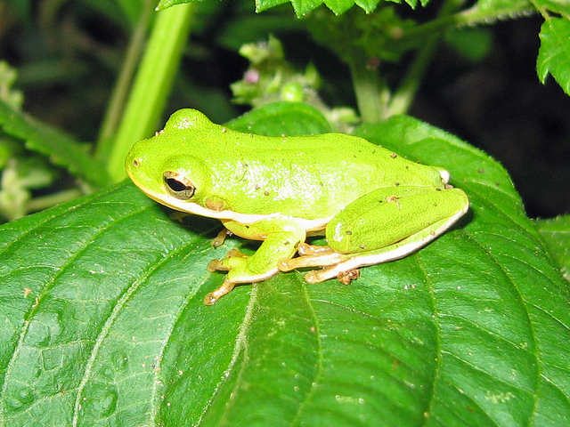

Slide 15
Where are we in the watershed?
Notes:
Point out Baltimore County on the map

Slide 16
Bob the Trout
https://www.youtube.com/watch?v=606LccnGOUM

Slide 17
Chesapeake Bay Clean Water Act
n December 2010—after years of missed deadlines for restoration and no consequences—the Environmental Protection Agency (EPA) exercised its Clean Water Act authorities by releasing enforceable pollution limits for nitrogen, phosphorus, and sediment pollution in the Chesapeake Bay. Subsequently the six Bay states and the District of Columbia released their plans to meet those limits by 2025. Together the pollution targets and the states' plans comprise a Clean Water Blueprint for the Chesapeake and its rivers and streams.

Slide 18
Nitrogen, Phosphorous, & Sediment
Nitrogen and Phosphorous feeds microalgae.
Algae prevents sunlight from reaching underwater plants. So does sediment
Underwater plants die, so oxygen levels in the water drop.
Fish and shell fish die → Eutrophication or “ Fish Kills”

Slide 19
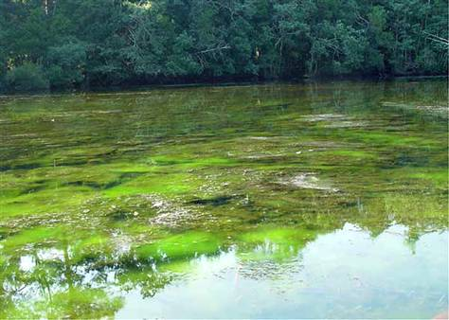
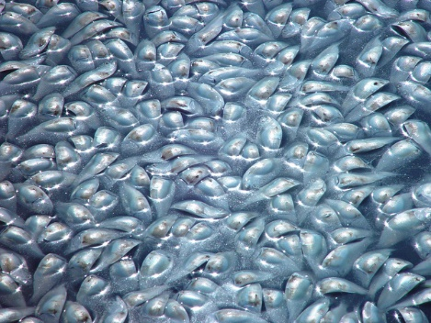
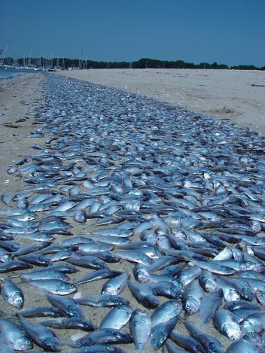
Microalgae feeds on the high levels
of nitrogen and phosphorous.
The algae kills underwater plants,
which in turn kills fish and shellfish

Slide 20
Question for the class…
Where do these high levels of nitrogen, phosphorous come from?
Sediment → Overdevelopment, impervious surfaces (concrete / asphalt ), erosion caused by farmland ( agriculture )
Nitrogen, phosphorous → pesticides and fertilizers used in agriculture
Notes:
Pose the question to the class, let them discuss in small group before revealing answers.

Slide 22
Agricultural runoff
We obviously need farms to produce food. Each farm in the United States feeds an average of 155 people daily.
But the processes and materials used by farmers severely hurts the Chesapeake Bay.
So what’s the solution?

Slide 23
Discuss in small groups some possible solutions to the agricultural impact on the Chesapeake Bay Watershed.
Construct a graphic organizer or awareness poster which demonstrates the impact of agricultural runoff on the Chesapeake Bay Watershed.

Slide 24
What Needs To Be Done?
The largest source of pollution to the Bay comes from agricultural runoff, which contributes roughly 40 percent of the nitrogen and 50 percent of the phosphorus entering the Chesapeake Bay.
The fastest growing source of nitrogen pollution to the Bay is polluted runoff.
Agriculture may be the biggest source of pollution, but it is also presents the biggest opportunity. Implementing conservation measures on farms is one of the most cost-effective ways to reduce pollution to our local streams, rivers, and the Bay.

Slide 25
These practices include:
Implementing nutrient management and conservation plans;
Planting cover crops
Fencing animals out of streams
Installing and maintaining grassed or forested buffer strips along farm fields.
Farmers have shown a willingness to help, but they need financial and technical assistance to do so. That is why CBF has and will continue to fight at the state and federal level for conservation funding for the Bay’s farmers.
Notes:
Planting cover crops like radishes helps to keep erosion low. This will keep the nitrogen and phosphorous out of the waterways. Keeping animals like horses, cattle, etc will reduce the levels by limiting what they are carrying in, as well as what is found in their waste. Buffer strips will further reduce erosion and run-off.

Slide 26
Other solutions to nitrogen and phosphorus pollution include:
upgrading storm water systems and sewage treatment plants
proper operation of septic systems, using nitrogen removal technologies on septic systems
decreasing fertilizer applications to lawns.

Slide 27
Because roughly one-third of nitrogen pollution comes from the air, we can conserve energy, which will result in fewer demands on power plants that emit nitrogen, and driving less, which reduces vehicle emissions that also contribute to airborne nitrogen loads

Slide 28
Important natural filters such as forests, oysters, wetlands, and underwater grasses need to be protected and restored. Overall, the Bay has lost 98 percent of its oysters, about 80 percent of grasses, and nearly 50 percent of forest buffers.

