Slide 1
Stewardship
Saving the Ecosystem:
Top Ten Ways it’s Being Destroyed!

Slide 2
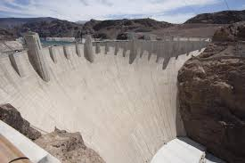
10 Building Dams
Dams Ravage their surroundings
Increase Landslides
Choke Rivers with Silt
Increase Seismicity (Earthquakes)
Notes:
Dams cut off fish migrations
Silt – sediment builds up behind the dam – decreases oxygen in the water – kills fish

Slide 3
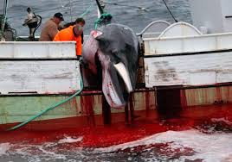
9 Overfishing
Global fishing fleet is 2.5 times larger than what our oceans can support
90% of the oceans large fish - tuna, swordfish, marlin, cod, halibut, and flounder has been pushed out of their natural habitats
Fish population will decline by 80% in next ten years
Whaling
pictured
here!!!
Notes:
Japan – round up and kill up to 100s of dolphins and whales at a time ; global efforts are being made to stop this.

Slide 4
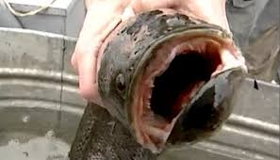
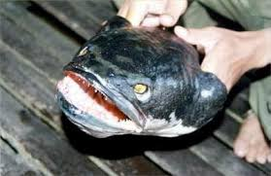
8 Invasive Species
New animal species in a new place throws the natural balance of an ecosystem out of order like the snake head fish pictured on this slide.
New plant species like the Spanish Moss plant can take over and kill other vegetation.
Snakeheads are
viscous and can walk
on land!!!
Notes:
Invasive species have no natural predators – nothing to keep them in check

Slide 5
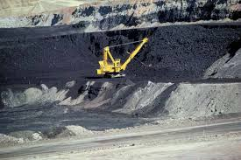
7 Coal Mining
Entails “strip mining” or mountain top removal
Kills trees and animal life
Appalachia forest in Western Maryland could disappear in the future
75% of streams and rivers are polluted by the coal mining industry.
Notes:
Burning of coal ( like any other fossil fuel ) is the primary source of air pollution.

Slide 6
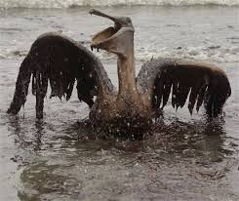
6 Human Accidents
Oil Companies can have disastrous accidents such as the Exxon Valdez spill in Alaska in 1989.
250,00 seabirds were killed
2,800 sea otters were killed
300 harbor seals were killed
250 bald eagles were killed
22 killer whales were killed

Slide 7
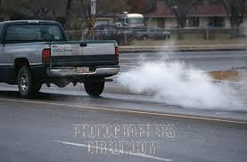
5 Cars
Cars give off 1/5 of all greenhouse gas emissions
Average car emits 12,000 pounds of carbon dioxide in a year.
Puts nitrogen oxides in the air along with hydrocarbons and sulfur dioxide

Slide 8
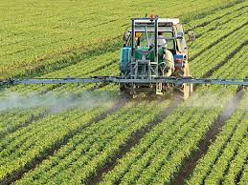
4 Unsustainable Agriculture
Responsible for 70% of pollution in rivers and streams
Pesticides increase nitrogen level and lower oxygen level in water
Kills fish and other natural wildlife
Notes:
Fertilizers – increase nitrogen in water – algae grows in abundance – takes oxygen out of water – fish die – if fish die, animals that eat them die or have to relocate.

Slide 9
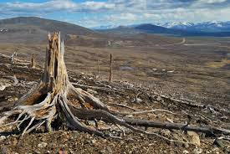
3 Deforestation
32 million acres of Rainforest lost each year
70% of plants and animals in the rainforests lose their natural home
Contributes to global warming
Slash and burn techniques pollute environment
Notes:
Less trees to take carbon dioxide out of the air – build up of “ Greenhouse Gases “ keeps radiation from the sun from being able to go back out of the atmosphere – global warming

Slide 10
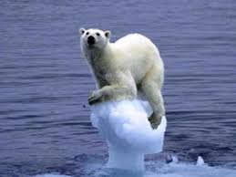
2 Global Warming
Makes the average earth temperature rise
20% of the ice caps have disappeared
Sea levels are flooding waters edge communities
Carbon dioxide is on the rise creating the “greenhouse effect”
Notes:
Polar Bears most likely extinct as early as 2050 – National Geographic

Slide 11
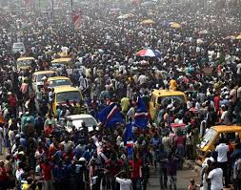
1 Overpopulation
Worlds population has grown from 3 billion to 6.7 billion in the past 40 years
Means more WASTE, more food demand, more cars etc…
Endanger wildlife as land is taken for cities
Increased carbon emissions
Notes:
Struggle between land use for housing and land use for agriculture to feed growing population. Not enough farmland to feed population by as early as 2030 - BBC

Slide 12
Group Work!!
Now in your Cooperative Groups Discuss and fill in column 3 of your classwork ditto entitled “Fixable Solutions!”
Be prepared to discuss and share!
Then complete your assessment!

