Slide 1
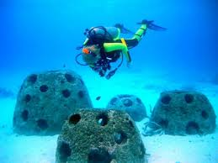
Join the Green Club on Tuesday March 3rd and March 10th to build Reef Balls
Help the Chesapeake Bay and have fun doing it!!
Mr. Compher’s room 210
3pm

