Slide 1
The DMS Ecosystem
We need better health for the students at this school and we need it now.

Slide 2
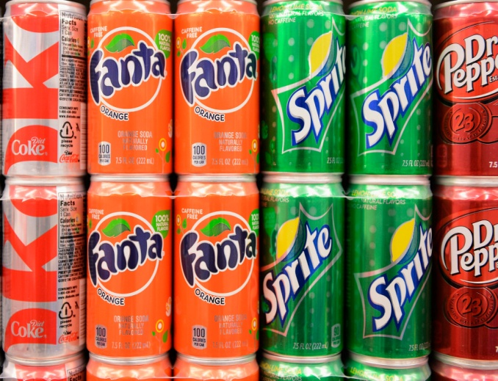
We need a lot of nutrients not caffeine
We will need lots of water bottles of water or fresh milk just we cant have students have soda cause it has a lot of caffeine in it so we need all students drinking stuff that is good for them.

Slide 3
Lunch everybody loves but what are the ingredients
Students eat a lot of stuff that isn't good for them like pizza it is good but there is stuff in their that isn't healthy at all so we should have healthier lunches.

Slide 4
When the students are sick they need better health care.
We should get a nurse and a assistant and their both at john Hopkins hospital and they might do a lot better for our school.

Slide 5
Recycling
Every one in our community needs to clean up their mess and either throw it away or recycle it and then we will have a better community.

