Slide 1
Dundalk middle
Ecosystem

Slide 2
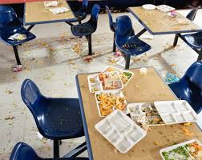
Problem
My problem is that trash is being thrown on the floor in the lunchroom and trash still on the table leftover and the teacher do not realize that when they tell us to clean the mess it is still there and nobody cares.

Slide 3
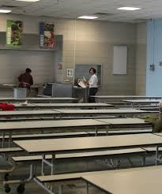
First solution
the kids can help clean the mess before they go to class just to help out a little.
see and this is what
happens when you clean
your cafeteria.

Slide 4
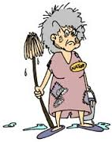
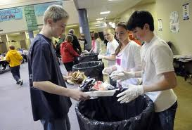
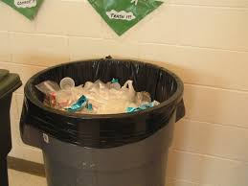
Second solution
If you see someone walk over trash then you can say “ hey can you pick up that trash please”. Then they will , and the people wont have to clean as much as they do now.

Slide 5
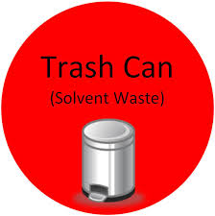
Final solution
If you see someone drop trash you can say “hey you drop that trash so can you please pick it up

Slide 6
Dundalk middle schools problem and solutions
A problem that bugs me about Dundalk Middle school is that trash being thrown on the floor in the lunchroom and trash still on the tables left over. And nobody cares at all Here are some solutions. You can ask them to help clean so the lunch ladies don’t have to clean as much. My next solution is if you see someone walk over trash you can ask them to pick it up before they go. The final solution I have is if you see some drop trash say “ you dropped that can you please pick it up.

